Slide 1
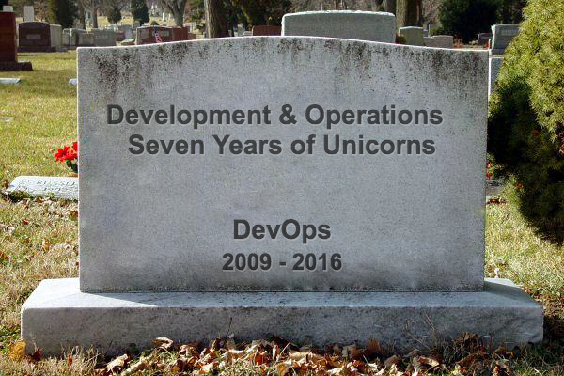
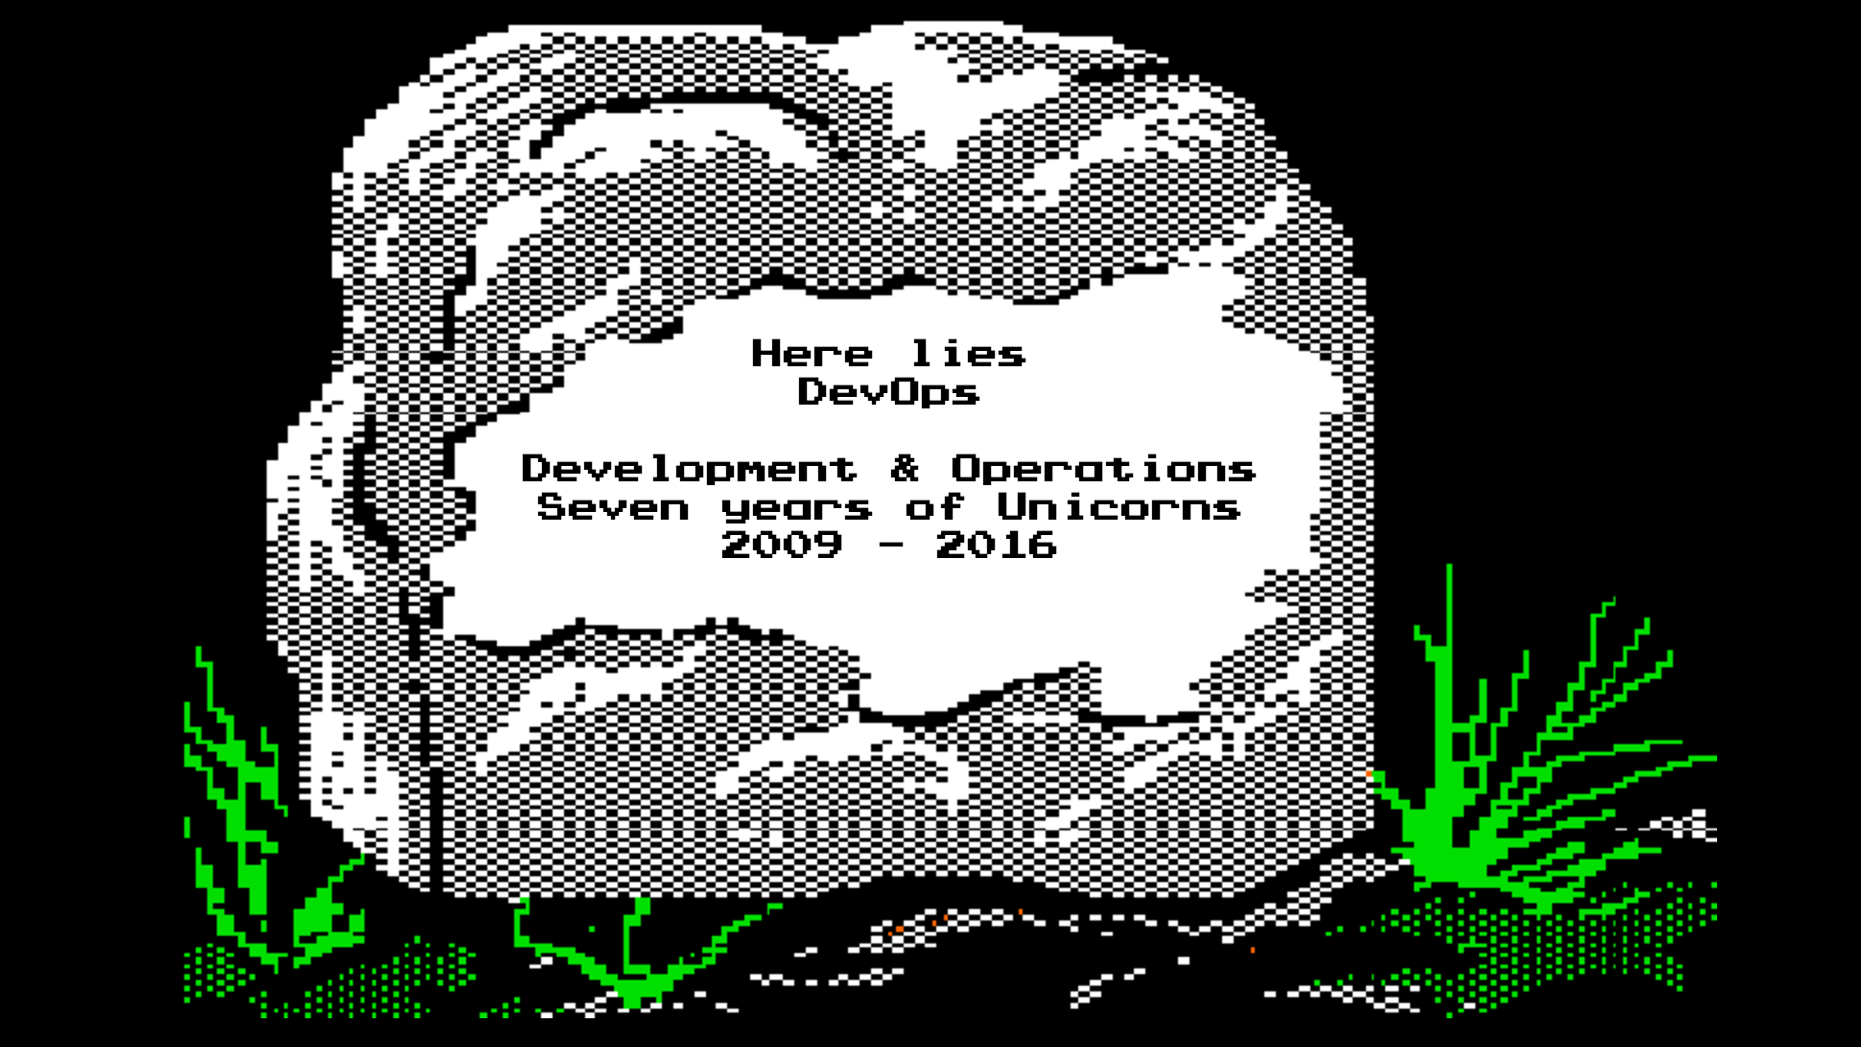
DevOps
RIP DevOps, picture of a headstone
Notes:
DevOps is dead.
It’s been a great run. We are approaching the seventh anniversary of DevOpsDays events.
There have been ?? DevOpsDays events since this started
All hope is not lost…let’s review some of the awesome things this movement has brought us and why I think it’s time to move on.
http://oregontomb.com/1QLAaGz
http://tombgen.appspot.com/

Slide 2
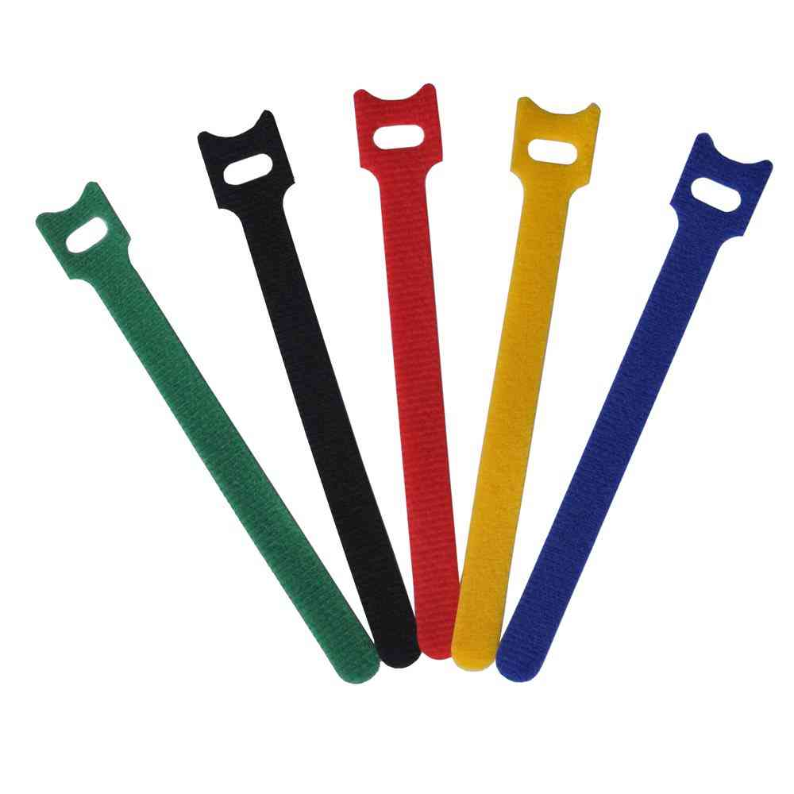
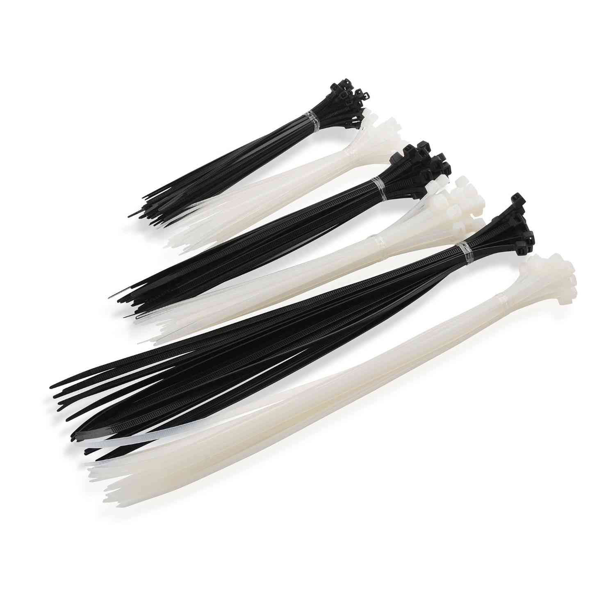
Agile Infrastructure
Notes:
Historians will look at an open space session at Agile conf as the ground zero for DevOps.
A topic of “Agile Infrastructure” was proposed. This was a time when many people looked at using velcro wire wraps instead of plastic wire ties as being “agile” with their infrastructure.
Of course, this was also the beginning of the cloud and infrastructure as code was becoming a “thing”, too.
http://www.amazon.com/gp/product/B00L2LGMO4/ref=s9_simh_hd_bw_b2872_p23_d0_i2?pf_rd_m=ATVPDKIKX0DER&pf_rd_s=merchandised-search-4&pf_rd_r=0MJKHPMKMDJRW3DGNJ7N&pf_rd_t=101&pf_rd_p=4b3e4eed-ee33-54a0-9b12-bf526d71668f&pf_rd_i=507844
http://www.amazon.com/Reusable-Fastening-Velcro-Cable-Microfiber/dp/B00XHSP728/ref=sr_1_6?ie=UTF8&qid=1462150140&sr=8-6&keywords=velcro+cable+ties

Slide 3
Cloud
Notes:
As clouds formed and we had new, easy ways of deploying and scaling applications. Accessible via an API, mostly reliable, and inexpensive to get started. Sure, there were some stability issues and we had to start thinking about building and scaling resilient systems a bit differently.

Slide 4
Developers Operating
Notes:
Picture: Anthrax
But Developers found new freedom with these APIs. They didn’t need to wait for IT or Operations to provision systems. Developer could build and run their own production systems in the cloud. It was awesome.
Anthrax started playing Public Enemy songs.

Slide 5
Operators Developing
Notes:
Picture: Public Enemy
Operations started embracing Infrastructure as Code, started focusing more on measurement and monitoring (Flava Flav), and were concerned about the safety of the cloud (S1Ws). Operations were finding themselves picking up other development practices like using version control systems and writing tests for their code.
Chuck D and Public Enemy wanted to collaborate with the developers.

Slide 6
DevOps
Notes:
Picture: Bring the Noise, Public Enemy and Anthrax
Now Dev and Ops really started working together.
They tore down walls, blew up silos, and started collaborating.
Learning from each other and giving back to the system so that it became much more than just the sum of it’s parts.

Slide 7
DevQAOps
Notes:
But not everything was perfect.
Had we forgotten about testing? Applications simply do not go directly to production, that’s not safe. QA is required and cannot be left out of the mix.
DevQAOps

Slide 8
DevSecQAOps
Notes:
Many security teams looked at DevOps and automated workflows being pushed and were scared. Manual processes were viewed as the way to security. After all, we know what commands were executed, we had one person responsible for securing systems, one responsible for securing applications. Overtime, they came to understand the benefits that automation provides: not only can we release fixes faster we can also ensure consistency across the entire infrastructure. Security is now part of DevOps. DevSecQAOps

Slide 9
Enterprise DevSecQAOps
Notes:
What about the Enterprise?!
Legacy systems, hundreds, thousands, of developers, years of inertia and organizational structure. Clearly DevOps in this environment must be different. What we need is Enterprise DevSecQAOps

Slide 10
Enterprise DevSecNetQAOps
Notes:
Switches, Firewalls, and all sorts of networking gear can me fully automated these days. We must include the Network Engineers in our club.
Enterprise DevSecQANetOps

Slide 11
Enterprise DevFinSecNetQAOps
Notes:
You cannot move from the data center to the cloud, from waterfall to agile without changing how budgeting works. You must understand the tradeoffs between capital expenses and operating expenses. How can you provide a yearly budget when you’re going to be building application iteratively and consuming compute and other resources on demand? Clearly, the finance team needs to be part of Enterprise DevFinSecQANetOps!

Slide 12
Enterprise DevFinSecNetQAGovOps
Notes:
Life, liberty, and the pursuit of happiness. These may not be the first things that come to mind when you think of the government but they are principles on which it was founded.
Bureaucracy, red tape, slow moving, wasteful. These words are likely closer to what comes to your mind. But we have a duty to help the government do better and there are many agencies within the government that want to improve. These people are also part of our DevOps Movement.
Enterprise DevGovFinSecQANetOps

Slide 13
Enterprise DevFinSecNetQAGovOps
Notes:
PCI-DSS, HIPAA, SOX, many of our organizations fall under one or more regulatory burdens. When the auditors walk in to the building our goal should be to show them that we’re compliant and that we care. Not to appease and excuse them from the building as quickly as possible.
Yes, governance and compliance is also part of DevOps….but the good news is that we can reuse “Gov” to have multiple meanings. We’ll overload that part of the new term.

Slide 14
Enterprise DevHRFinSecNetQAGovOps
Notes:
Keeping our teams happy, high functioning, and collaborating is, in part, an outcome of good human resource practices. Set aside you possible disdain for the name of the group or the idea that humans are resources to be managed and you’ll have to agree that HR plays a large and important role in your team. Is it possible for you to work on another team for a short period of time? Who drives recruiting in your organization? Can cross-functional teams be created to address a problem or work on a project without needing to change the org chart?
Enterprise DevGovHRFinSecQANetOps!

Slide 15
Rugged Enterprise DevHRFinSecNetQAGovOps
Notes:
Having security in the room isn’t enough. Security teams need to bring new practices to bear as well. Introducing lean principles to the practice of security and working together with dev and ops is often labeled Rugged DevOps. Some would even argue that DevSecOps and Rugged DevOps are identical terms. We wouldn’t led “Gov” be constrained to one meaning, nor will we let security only have one part of the word! It’s that important!
Rugged Enterprise DevSecNetQAGovOps

Slide 16
Rugged Enterprise DevLegalHRFinSecNetQAGovOps
Notes:
DevOps is about the community, too. We create, consume, and contribute open source software. Our legal team needs to be involved to make sure that your employees can do all of those things without having to jump through ridiculous hoops. This is the laptop I use to do work, this is the laptop I use to contribute to open source. I never contribute, only consume when in the office.
Rugged Enterprise DevLegalHRFinSecNetQAGovOps
Also, legal wouldn’t allow us to shorten the name of their group. Must be “Legal”

Slide 17
Rugged Enterprise DevLegalHRFinSecNetQAGovCustOps
Notes:
WAIT!!! How could we forget the customer?! Aren’t we doing all of this to delight the customers? We should are delivering business and customer value. How do we need to change and improve to improve and drive our customer’s success?
Rugged Enterprise DevLegalHRFinSecNetQAGovCustOps!

Slide 18
Ingredients vs. Cake
Notes:
Cake

Slide 19

DEVOPS
A cultural and professional movement, focused on how we build and operate high velocity organizations, born from the experiences of its practitioners.

Slide 20

WHO PRACTICES DEVOPS?
EVERYONE
We are not generalists – we are well connected specialists
We are all DevOps
Notes:
Everyone at Chef helps manage the account

